Slide 1
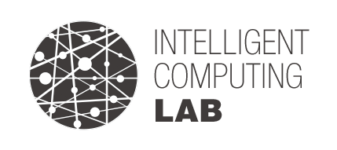
3D Pose Estimation using-Joint based Calibration in Distributed RGBD Camera System
Dataset & Code
Intelligent Computing Lab.
2023.10.02

Slide 2
Install
GitHub
Dependency
glfw.3.3.0
opencv4.10
cudnn64.7
dnn_model_2_0.onnx
Install
Azure Kinect DK Code Samples Repository
https://github.com/microsoft/Azure-Kinect-Samples/tree/master/body-tracking-samples
update code
/code/simple_3d_viewer ← Main Function
/code/sample_helper_libs/window_controller_3d ← Optimizer Code
Please also note that to use the Body Tracking SDK(Azure Kinect Body Tracking SDK download | Microsoft Learn) with Unreal, make sure you have added <SDK Installation Path>\tools to the environment variable PATH and copied dnn_model_2_0.onnx and cudnn64_7.dll Release Folder

Slide 3
Dataset Struct
Google Drive
Dataset A
HB
path : Dataset/Dataset_A_HB
data count : 50
2) JH
path : Dataset/Dataset_A_JH
data count : 50
Dataset B
HB
path : Dataset/Dataset_B_HB
data count : 1011
2) JH
path : Dataset/Dataset_B_JH
data count : 1035

Slide 4

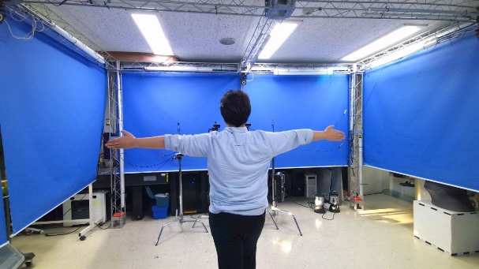
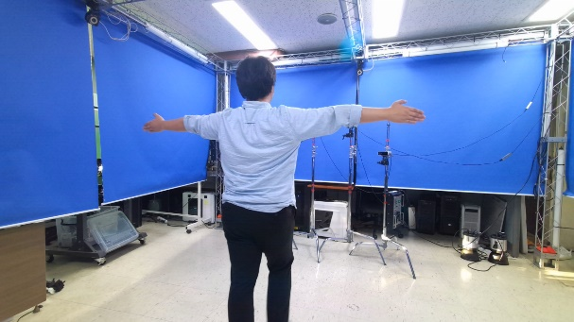
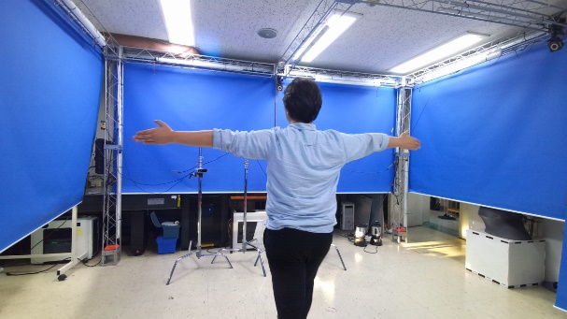
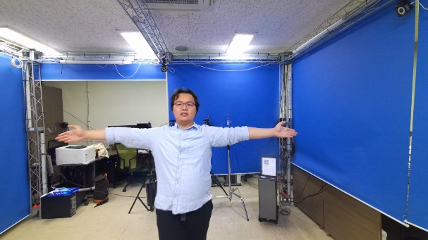
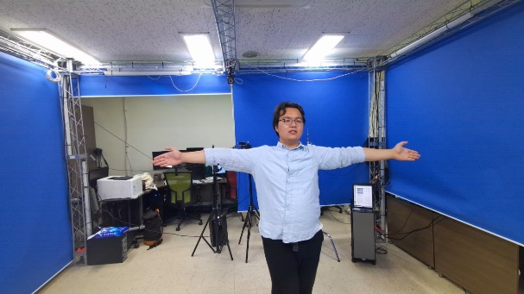
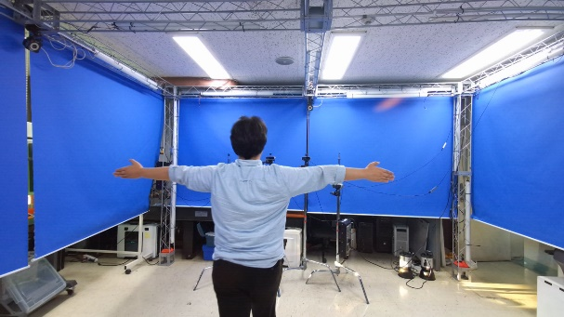
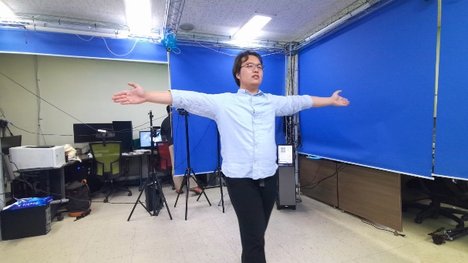
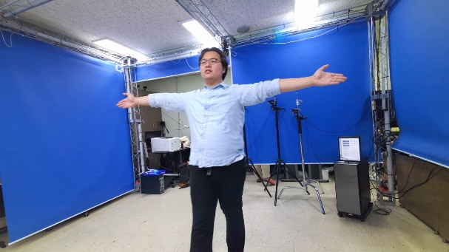
Dataset A
RGB (HB)

Slide 5
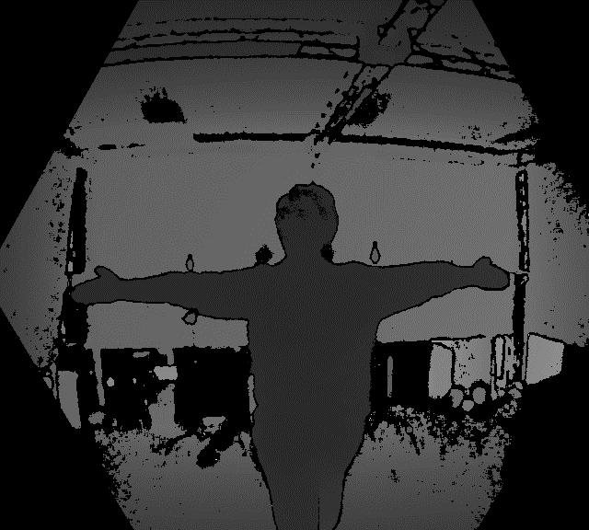
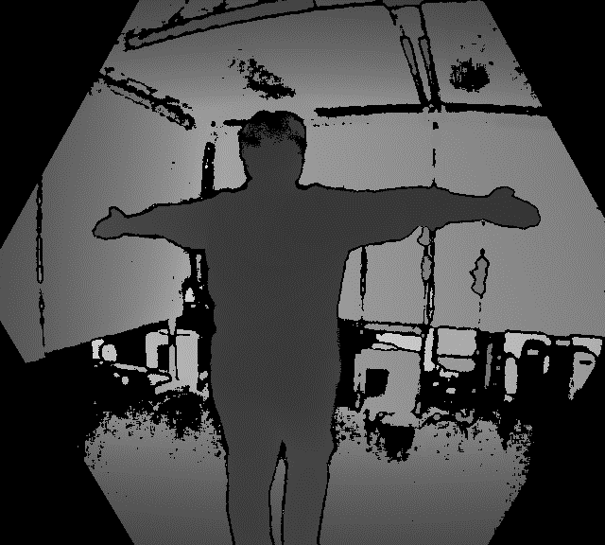
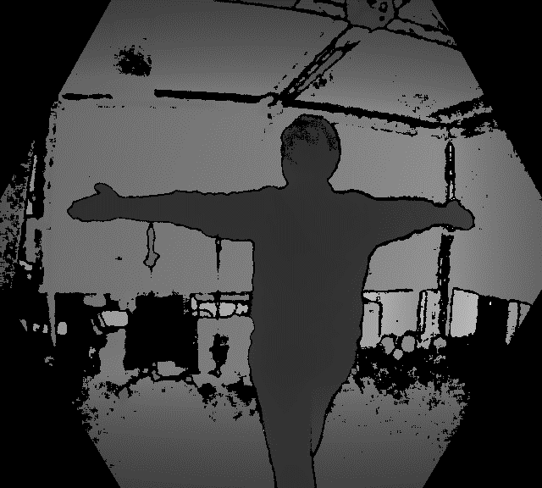
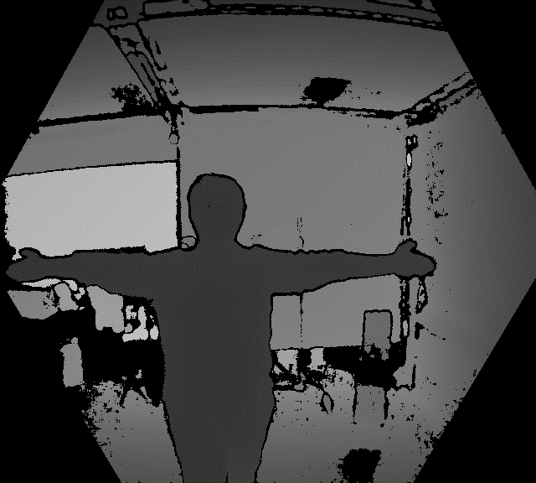
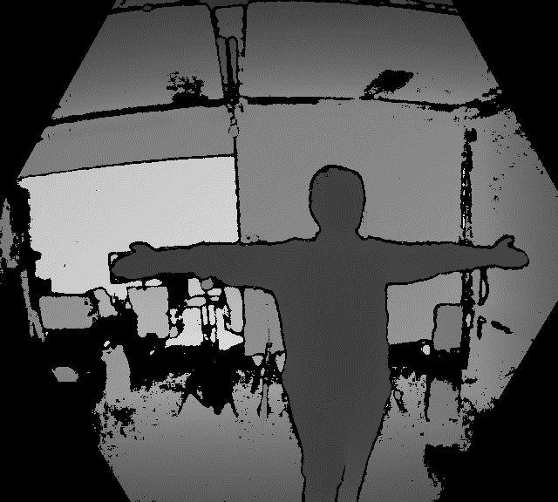
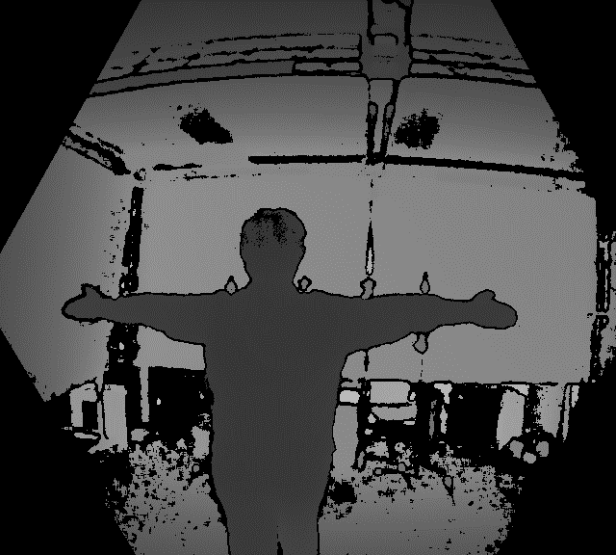
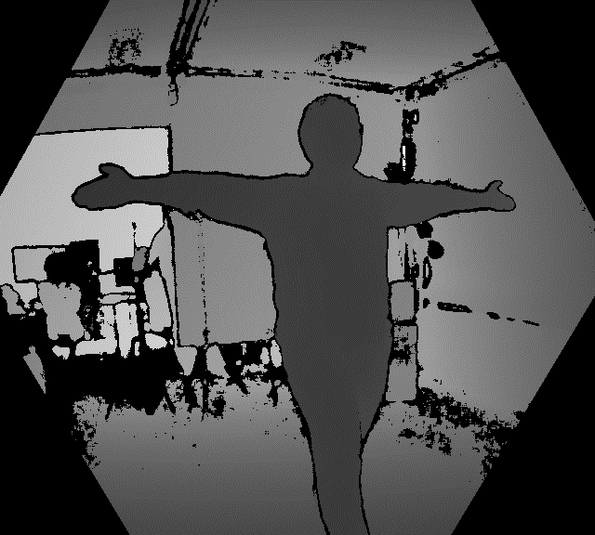
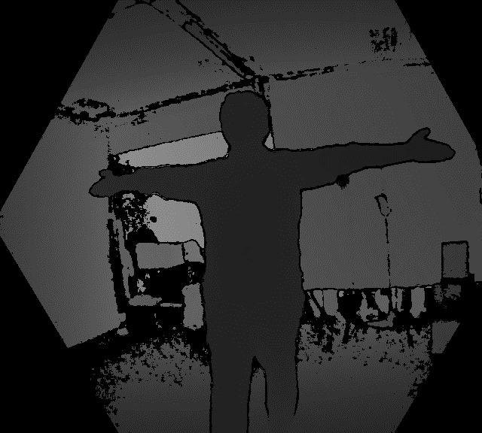
Dataset A
Depth (HB)

Slide 6
Dataset A
Pointcloud (HB)

Slide 7
Dataset B
3D Skeleton (HB)
Notes:
왼쪽 위부터 1~8

Slide 8
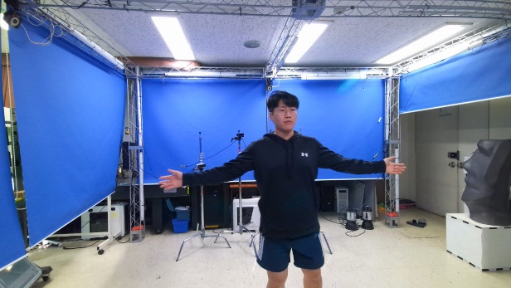
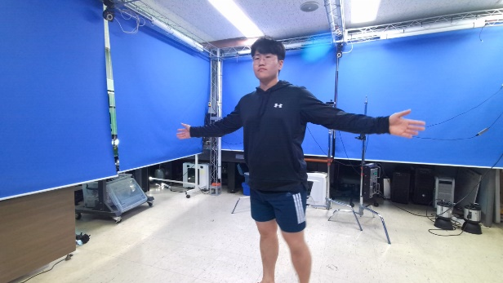
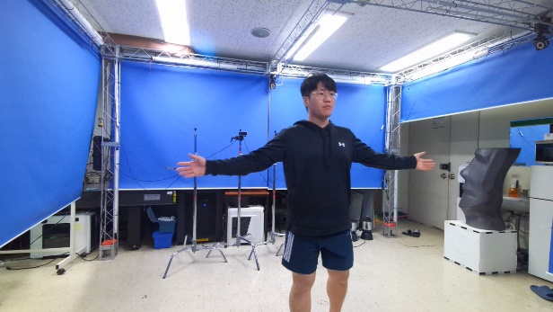
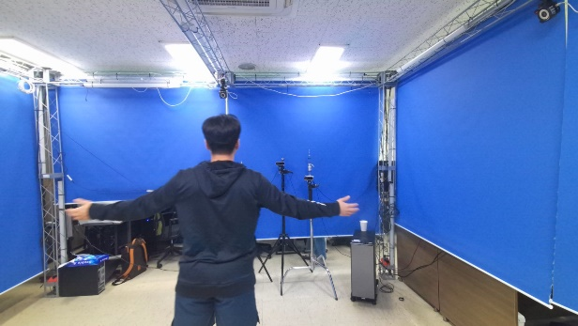
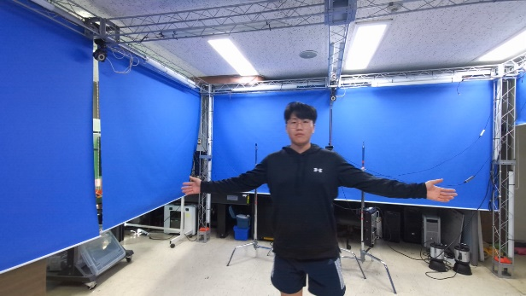
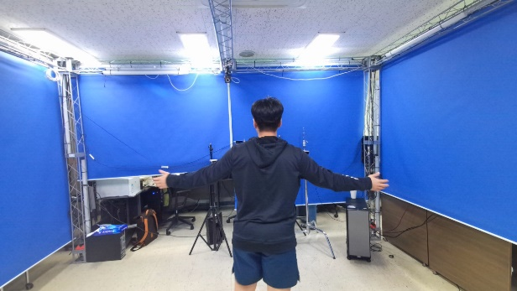
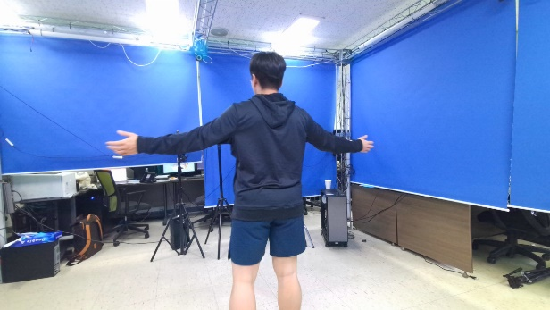
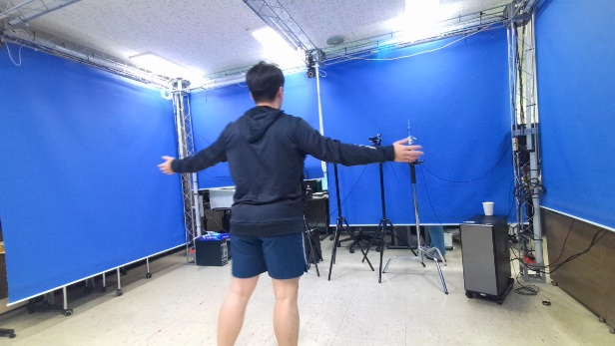
Dataset A
RGB (JH)
Notes:
왼쪽 위부터 1~8

Slide 9
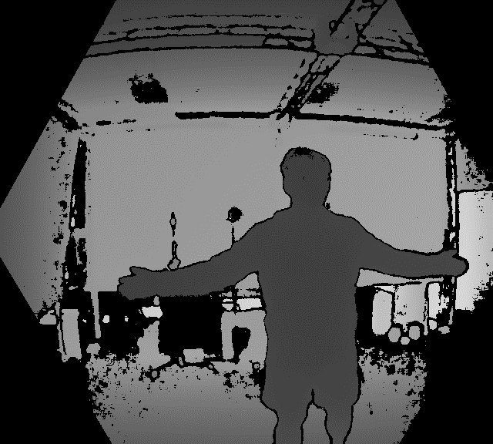
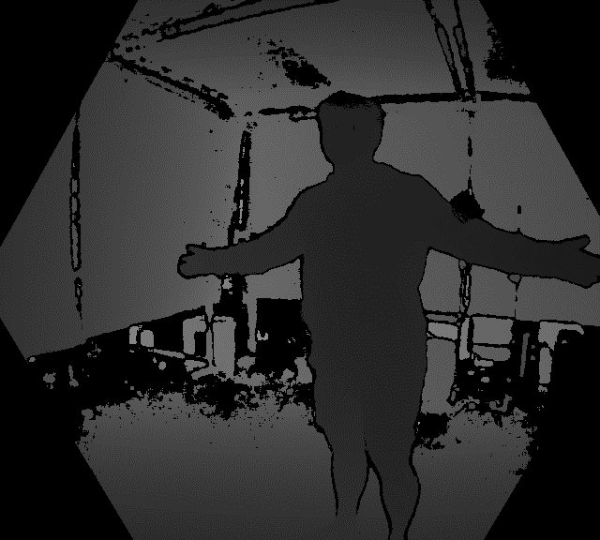
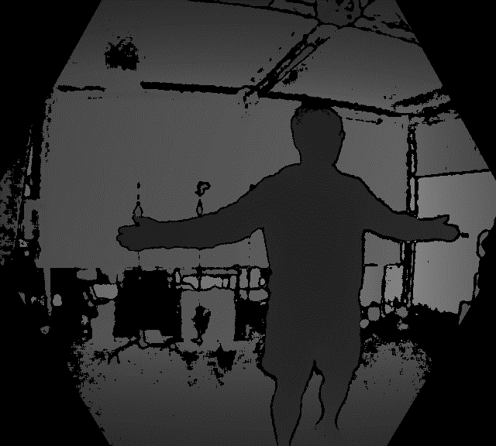
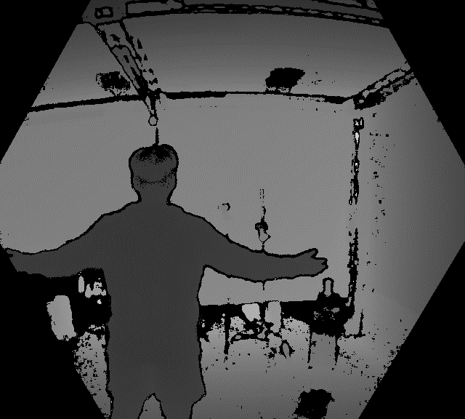
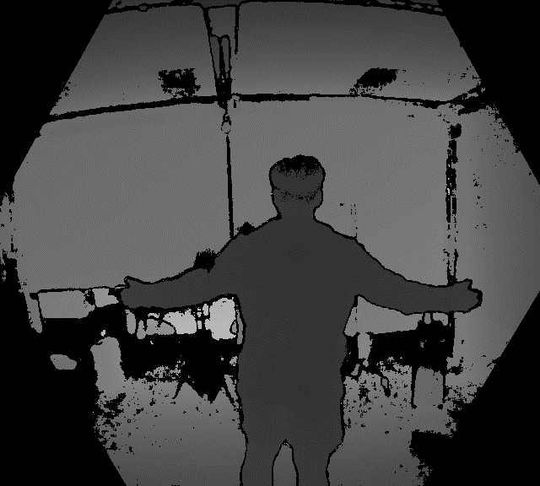
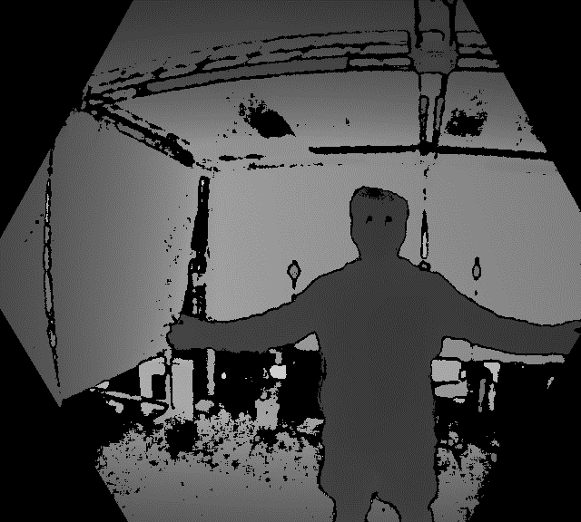
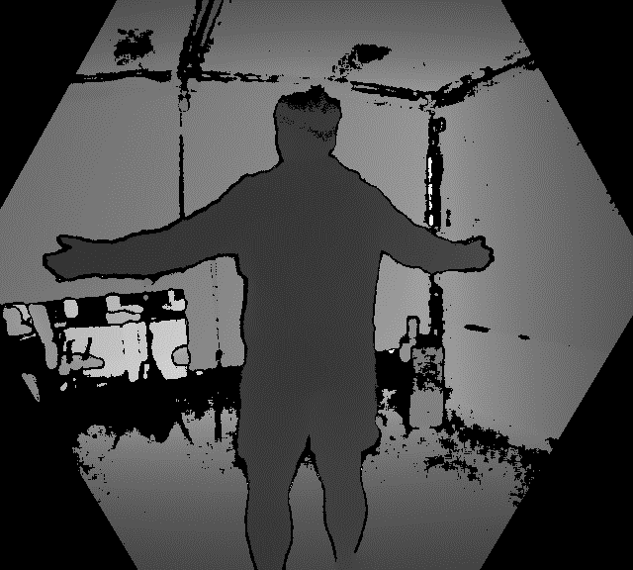
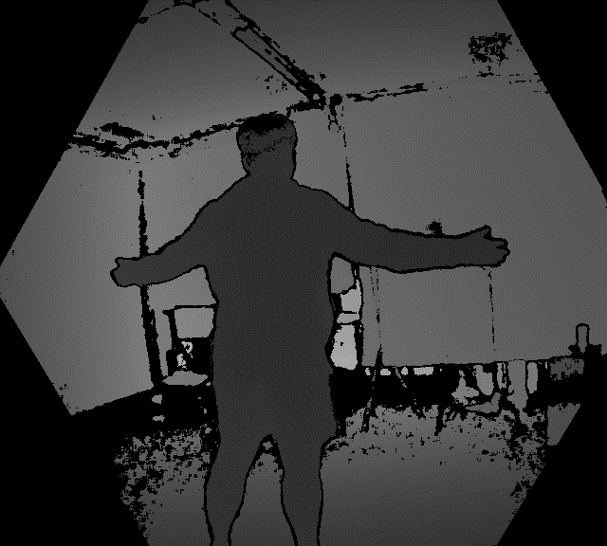
Dataset A
Depth (JH)
Notes:
왼쪽 위부터 1~8

Slide 10
Dataset A
Pointcloud (JH)
Notes:
왼쪽 위부터 1~8

Slide 11
Dataset A
3D Skeleton (JH)
Notes:
왼쪽 위부터 1~8

Slide 12
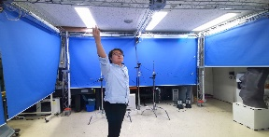

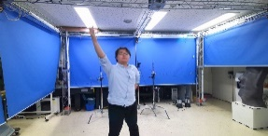
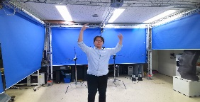
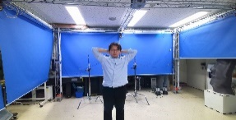

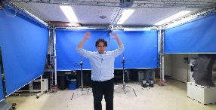

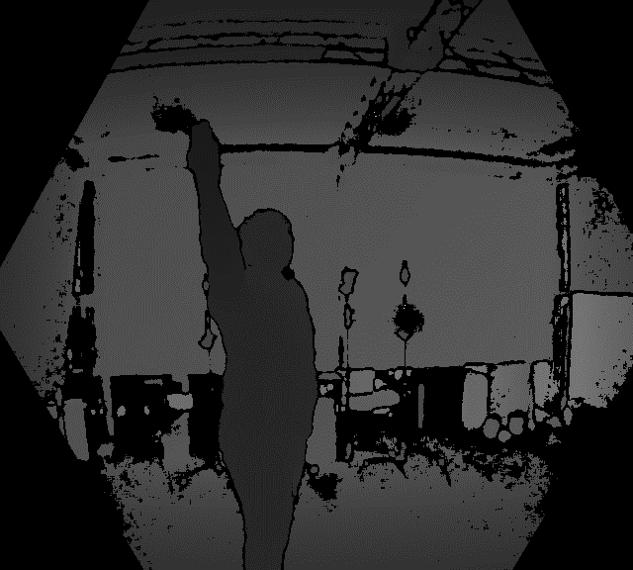

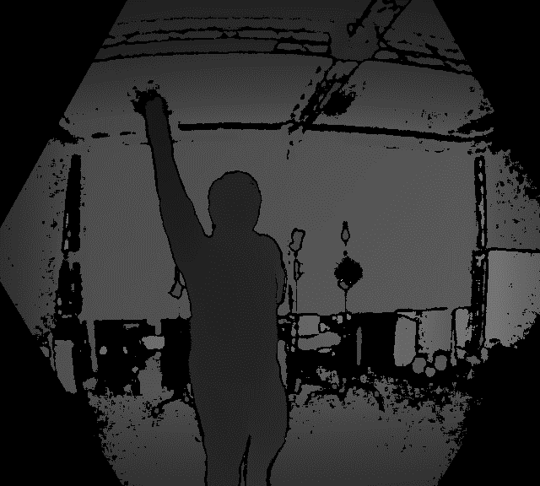
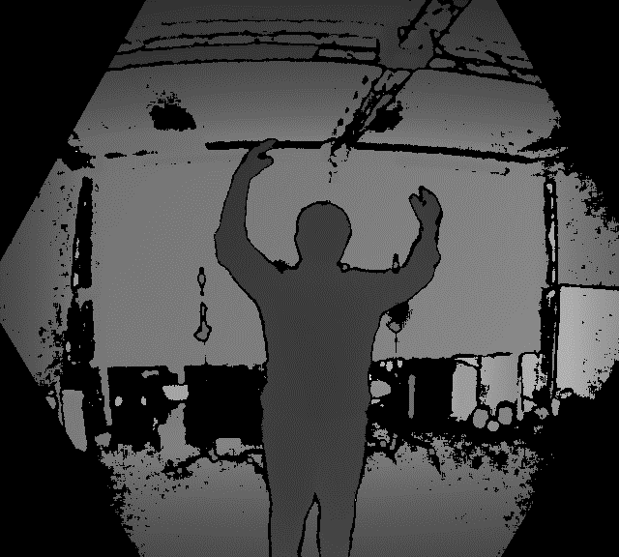
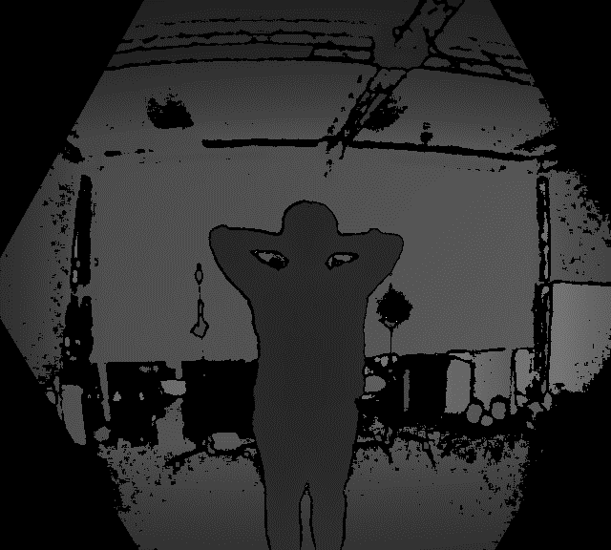

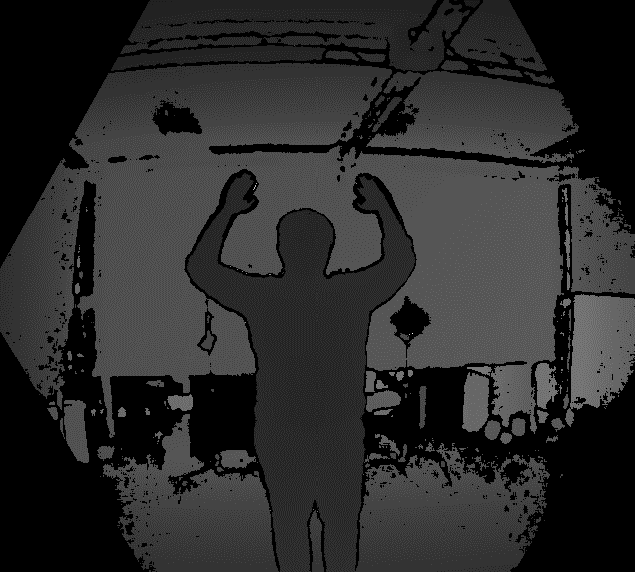
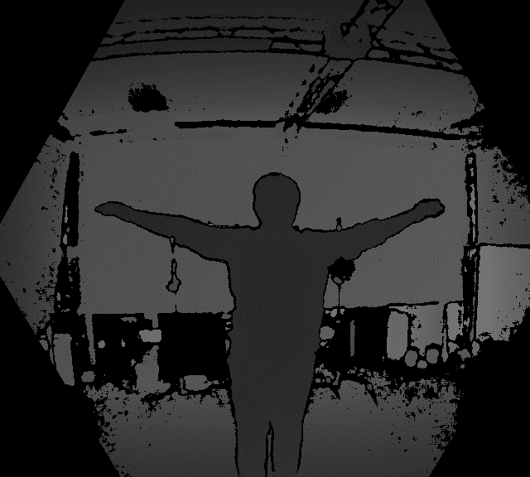
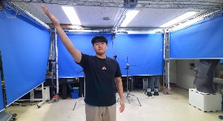
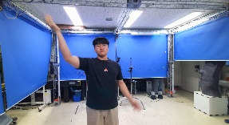
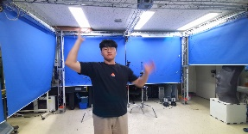
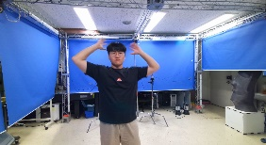
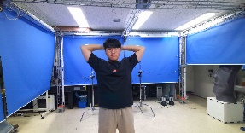
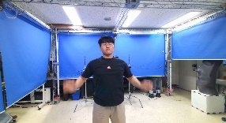










Dataset B
RGB-D Dataset (HB)
RGB-D Dataset (JH)
Notes:
왼쪽 위부터 1~8

